Slide 1

GAISE 2016
In Action
Beverly L. Wood, Ph.D.
Embry-Riddle Aeronautical University
Notes:
GAISE: the Guidelines for Assessment and Instruction for Statistics Education. The GAISE College Report was first endorsed by the American Statistical Association in 2005 and was widely disseminated to departments and faculty in North American and other English-speaking colleges and universities. The 2016 revision brought clarity to some parts of the original report and added a plethora of examples. A mixed methods study – funded by my college this past summer – included new and experienced instructors from two-year, four-year, and graduate level institutions. I am here to present some thoughts that emerged from survey and interview data about the awareness of and implementation efforts made by instructors.

Slide 2
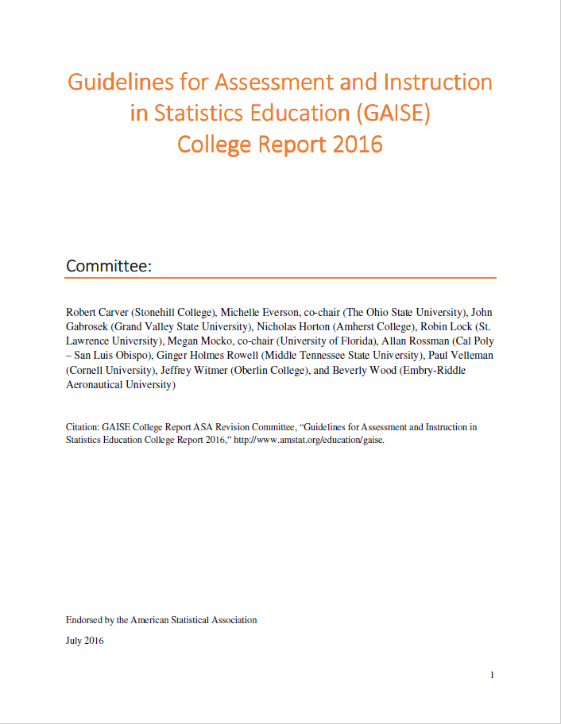
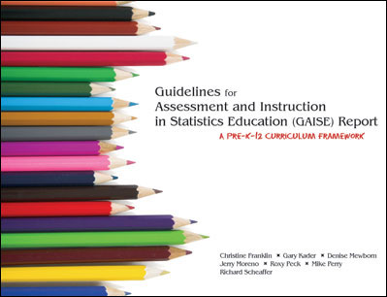
Guidelines for Assessment and Instruction in Statistics Education
Notes:
GAISE is actually a pair of reports; one for PK-12 and another for College. Together they have had a major impact on the teaching of statistics across the entire educational experience from prekindergarten through an undergraduate degree. These guidelines inform standards and practices across boundaries of nations, schools, and degree programs. Emphasis is on learning to make decisions, both personally and professionally, based on data in situations where uncertainty exists.

Slide 3


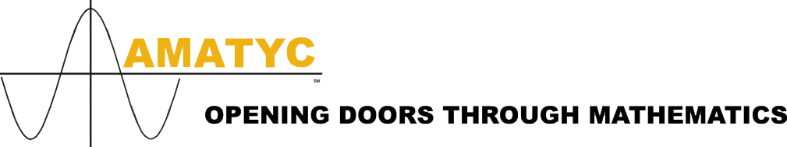
Research Question
How has the 2016 endorsement of the revised Guidelines for Assessment and Instruction in Statistics Education: College Report (GAISE 2016) influenced the teaching of statistics at tertiary educational institutions?
Notes:
The online survey was anonymous, self-selected and self-reported by instructors; survey participants were recruited through community boards for the Statistics Education groups with the
[click] American Statistical Association,
[click] Mathematics Association of America, and the
[click] American Mathematics Association of Two-Year Colleges.
There were 64 complete responses to forced choice questions, 48 to the open-ended questions and 38 volunteers for an interview;
9 half-hour interviews were conducted, 3 each from two-year, four-year undergrad, and graduate/research institutions.

Slide 4
Who took the survey?
Notes:
Name the “tallest” categories.
Interviewees were purposefully selected:
three from research institutions, three from primarily teaching institutions with mostly 18-23 yr olds attending full time, and three from community colleges with a wider variety of ages and enrollment status
Three teaching calculus-requiring courses to STEM majors, including math/stat/datasci; two teaching algebra-based courses to specific group of students; and four in gen ed
Three described their course delivery as a mix of synchronous and asynchronous, one from a research institution and two from a two-year college

Slide 5
How much of GAISE 2016 have you read?
Contents
Committee ..................................................................................................... 1
Executive Summary …..………........................................................................ 3
Introduction ................................................................................................... 4
Goals for Students in Introductory Statistics Courses ............................... 8
Recommendations ..................................................................................... 12
Suggestions for Topics that Might be Omitted from Introductory Statistics Courses ........................................................................................................23
References .................................................................................................. 25
APPENDIX A: Evolution of Introductory Statistics and Emergence of Statistics Education Resources ………………………..……………………………... 28
APPENDIX B: Multivariable Thinking ......................................................... 34
APPENDIX C: Activities, Projects, and Datasets ....................................... 43
APPENDIX D: Examples of Using Technology ……….................................. 66
APPENDIX E: Examples of Assessment Items ........................................ 104
APPENDIX F: Learning Environments ...................................................... 131
Notes:
I’m showing you the Table of Contents for the Report for two reasons: illustrating the increased size of the report and to identify the focus areas for the study. Page 24 of the 61 pages in the original report is where the four appendices began. Nearly all of the new material and the additional 80 pages of the revised report is in the immediately useful classroom materials in Appendices B-E.
[CLICK] To answer the research question, my survey and interview protocol focused on the meat of the Report. The open-ended prompts on the survey unsurprisingly included discussion of the most controversial [CLICK] part of the report. The interviewees also brought this up, but more time was spent on what might be newest idea [CLICK] made explicit by GAISE 2016.

Slide 6
Students should become critical consumers of statistically-based results reported in popular media, recognizing whether reported results reasonably follow from the study and analysis conducted.
Students should be able to recognize questions for which the investigative process in statistics would be useful and should be able to answer questions using the investigative process.
Students should be able to produce graphical displays and numerical summaries and interpret what graphs do and do not reveal.
Students should recognize and be able to explain the central role of variability in the field of statistics.
Students should recognize and be able to explain the central role of randomness in designing studies and drawing conclusions.
Students should gain experience with how statistical models, including multivariable models, are used.
Students should demonstrate an understanding of, and ability to use, basic ideas of statistical inference, both hypothesis tests and interval estimation, in a variety of settings.
Students should be able to interpret and draw conclusions from standard output from statistical software packages.
Students should demonstrate an awareness of ethical issues associated with sound statistical practice.
Goals for Students in Introductory Statistics Courses
Notes:
Sorry for the text torture! I’ve emphasized the big idea in each of the nine items and hope that you can read at least that much. GAISE 2016 re-framed the goals that were a bulleted list in the original report and provided at least a paragraph of description for each. These sentences are not exactly a set of course learning outcomes, but this is a great list to start with to create some.
[CLICK] The multivariable language here was not a talking point in the survey or in the interviews, although it is when we get to the Recommendations section. It seems that there’s consensus that students should see it during an introductory course, just many questions about exactly how to do it.
[CLICK] Let me share some interview quotes related to the last two goals.

Slide 7
Students should be able to interpret and draw conclusions from standard output from statistical software packages.
“there is so much output in the statistical software and I think that making them stand up there and actually pull out…what are the few key pieces of information.”
“I’ve stopped using a calculator and have only been teaching with StatCrunch …teaching them how to plug-and-chug on a
graphing calculator is not a transferable skill.”
Minitab
JMP
R
SPSS
Web applets
StatCrunch
Excel
Students should demonstrate an awareness of ethical issues associated with sound statistical practice.
“I’ve been struggling what to do with the ethical issues.”
“Kind of more of the hidden curriculum, because I know we are going
to hit it [in projects and activities]…I know it is coming”
“We don’t do a great deal about ethics…should probably do some more.”
Notes:
Interviewees mentioned several different [CLICK] software packages they have used…currently, in the past, or plan to in the future; several discussed the difficulty in choosing a package that fits their students’ abilities and needs. [CLICK] These quotes came in the context of students being able to interpret the values that a computer has calculated.
<pause for reading>
[CLICK] Like the inclusion of multivariable models, the conversation related to ethics was much more about how to explicitly include it rather than a question of whether we should or not.
<pause for reading>

Slide 8
Recommendations for Teaching
1. Teach statistical thinking.
Teach statistics as an investigative process of problem-solving and decision making.
Give students experience with multivariable thinking.
2. Focus on conceptual understanding.
3. Integrate real data with a context and purpose.
4. Foster active learning.
5. Use technology to explore concepts and analyze data.
6. Use assessments to improve and evaluate student learning.
Notes:
The six numbered recommendations are very similar to the six in the original report, which expanded from the three [CLICK] given in the Teaching Statistics chapter of the 1992 MAA publication, Heeding the Call for Change: Suggestions for Curricular Action.
[CLICK] These two bullet points are new in the fact that they are clearly stated here. The first was implied in the original report and textbooks being used at the time of the 2016 revision work generally laid out the [CLICK] process, though often in a linear way. The second bullet was the only surprise to any statistics instructor who had knowledge of the original GAISE College Report and maybe not even then. [CLICK] Survey and interview responses on the inclusion of multiple variables identified a struggle with the meaning of this if it is not a call to teach multiple regression to all students. Some interviewees were relieved to see the examples provided in the appendix that we discussed next.

Slide 9

Appendices
APPENDIX A: Evolution of Introductory Statistics and Emergence of Statistical Education Resources
APPENDIX B: Multivariable Thinking
APPENDIX C: Activities, Projects, and Datasets
APPENDIX D: Examples of Using Technology
APPENDIX E: Examples of Assessment Items
APPENDIX F: Learning Environments
Notes:
Among the survey respondents there were not many comments around the expanded set of appendices other than [CLICK] gratitude. As I already mentioned, examples in Appendix B of multivariable thinking that are not multiple regression done by students was a relief to some concerned instructors, particularly those at two-year colleges.

Slide 10

Suggestions & Further Conversation
Adoption by all faculty teaching statistics
Mathematicians
Other disciplines
Textbooks
Articulation agreements and common course outlines
Resources for teaching to specific audiences, notably the health sciences
Ongoing professional development
Notes:
[CLICK] Interviewees shared thoughts on both direction about this. They were happy to have GAISE, the original or the revision, as leverage to convince colleagues to adopt a new approach to teaching statistics. They also expressed concern about the lack of awareness of faculty in other departments the where statistics is taught as well as the unconvinced faculty inside their own math/stat departments.
[CLICK] Discussion about textbooks also occurred in both positive and negative ways. Some expressed regret that not all textbooks being used in their department were GAISE-aligned, while others told of adoptions of particular textbooks that forced adjustments in course delivery, in some cases inspiring math faculty to no longer teach statistics. A couple of interviewees were concerned that publishers say they are GAISE-aligned but the content really doesn’t change. Multivariable examples and coverage of ethical issues are still sparse.
[CLICK] One suggestion was for a careful look at articulation agreements that transfer credit from a two-year to a four-year institution to expedite adoption by the primarily mathematicians at community colleges. Another pointed out shared state or institutional course descriptions and learning outcomes that continue to reflect the consensus curriculum of the previous century.
[CLICK] Finally, those teaching in the health sciences wished for additional health-related resources.
[CLICK] Let me add that in the course of the interviews most of those 9 instructors told me that they first learned about GAISE at some kind of professional development opportunity: USCOTS, StatPrep, ISI workshop, publisher-sponsored event. It reminded me that there are always new educators coming into the faculty so there is always an audience waiting to find GAISE.

Slide 11

Thank You
Beverly L. Wood, Ph.D.
woodb14@erau.edu

